Slide 1
Fundamentals of Programing
ITC 1063

Slide 2
Group Members and Group Name
Group Name – Bug Busters
Group Members
ICT/22/804 – Eshan Alahakoon
ICT/22/805 – Hiruni Prabodhya
ICT/22/890 – Sadini Nipunika
ICT/22/940 – Pathum Weerakoon

Slide 3
Content
Introduction
Login page
Connecting code
Dashboard
Staff
Book
Student
admin

Slide 4

Library
Management System
We prepared this for admins who control this system

Slide 5
Introduction of the System
Currently, the system is completely controlled by the admins. The admins do all the things like entering books into the system, giving them out, registering students, registering staff members, and storing their details.

Slide 6


We use these to create
Language – Java
Software- Apache NetBeans
Database – my SQL

Slide 7
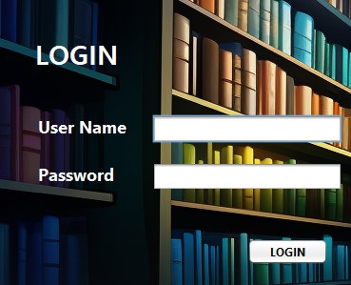
Login Page
In the login page, admin gives a student id and a password to the student.
But in this system student can't login only admin can access this.

Slide 8
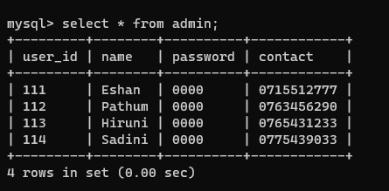
Admin table
When we login using the user name and password then check in the table is it valid one.

Slide 9
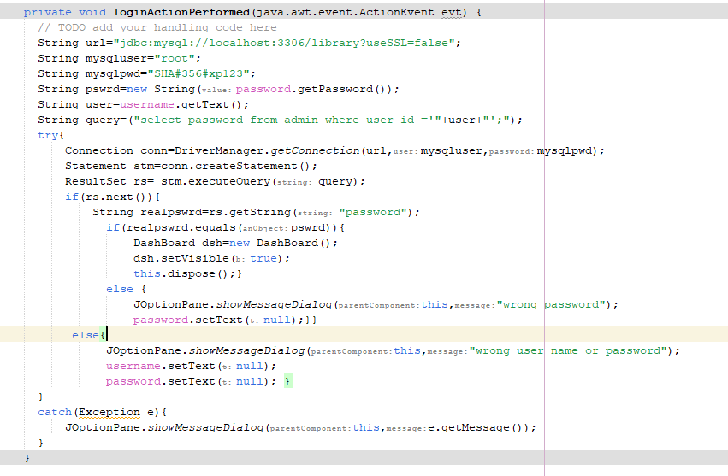
Connecting code

Slide 10
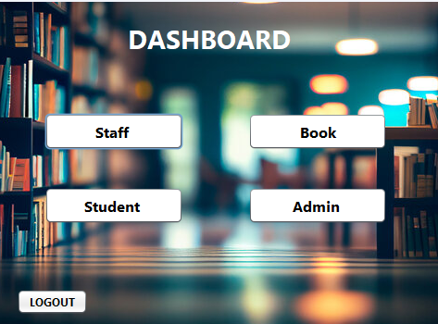
Dash board
This is Dashboard. Divided this dashboard to 4 main tasks and we also give a logout option. Let’s see this 4 options one by one.

Slide 11
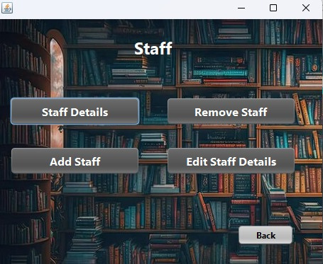
Staff
When we click on the staff label, we came to this interface. In here we can see that options. Only admin can change these data.

Slide 12
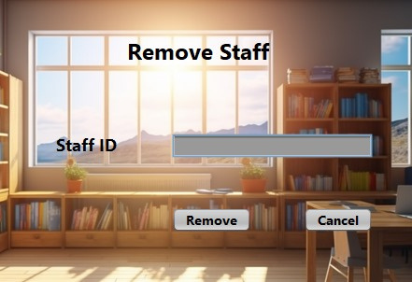
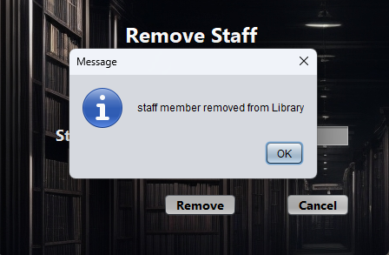
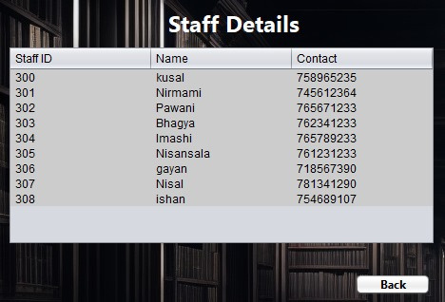
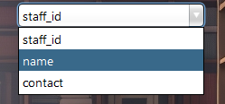
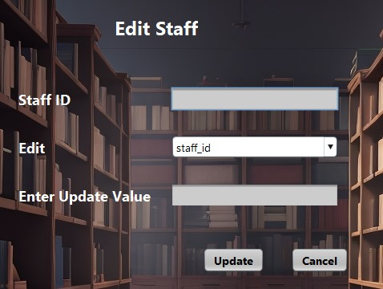

Slide 13
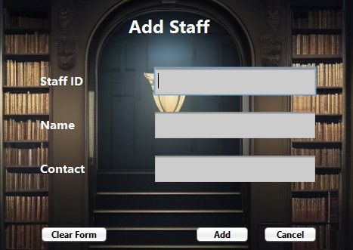
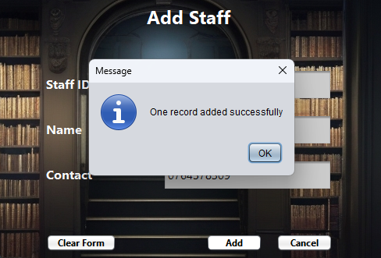

Slide 14
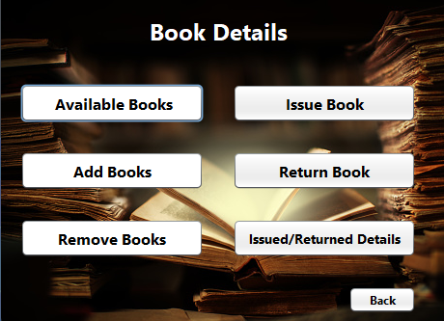
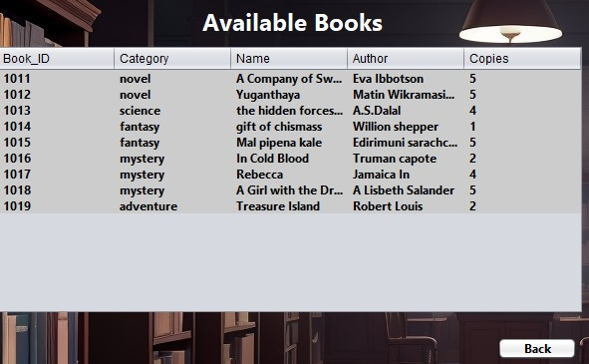
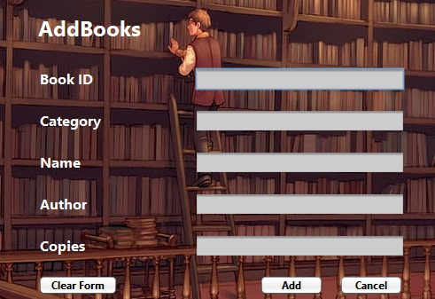
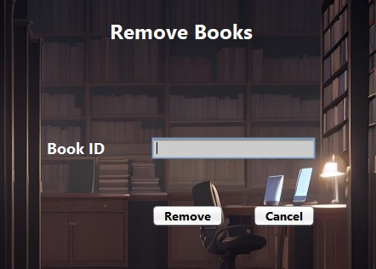
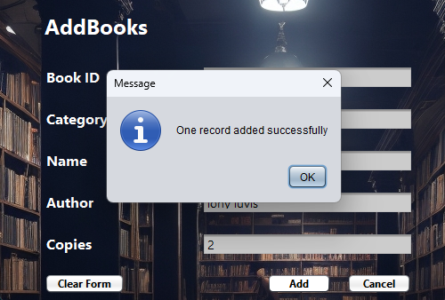
Book

Slide 15
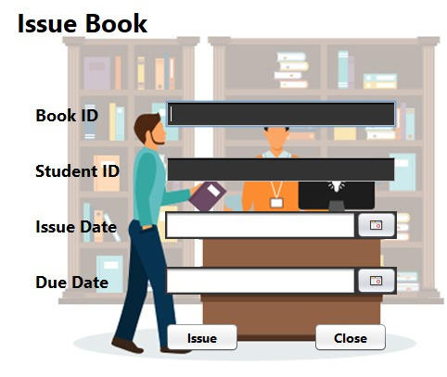
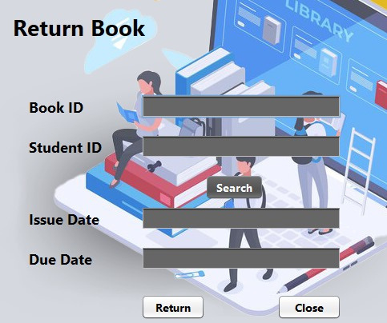
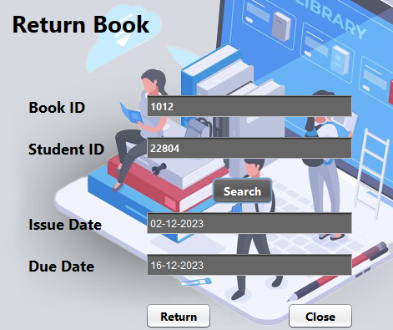
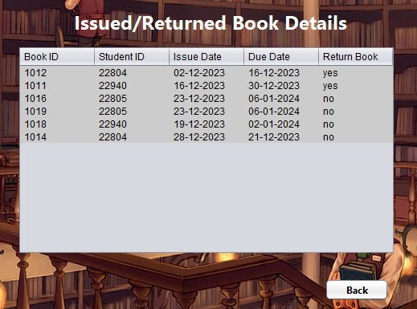
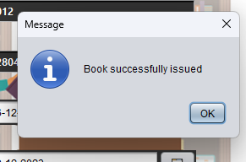
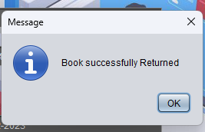

Slide 16
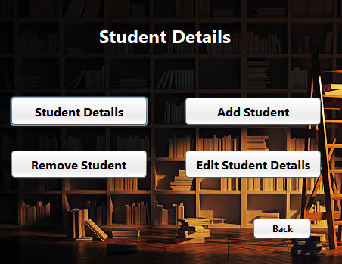
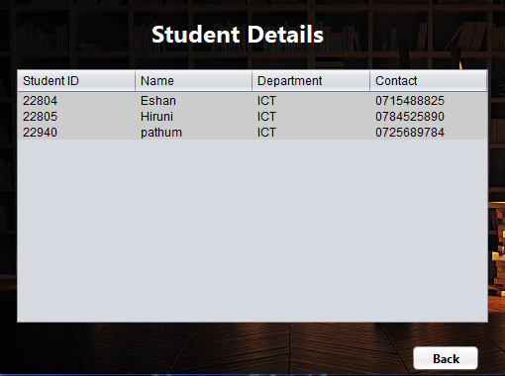
Student

Slide 17
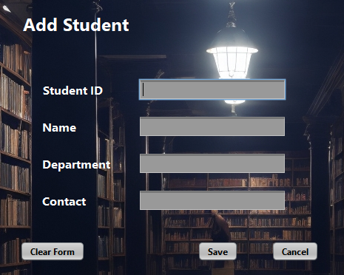
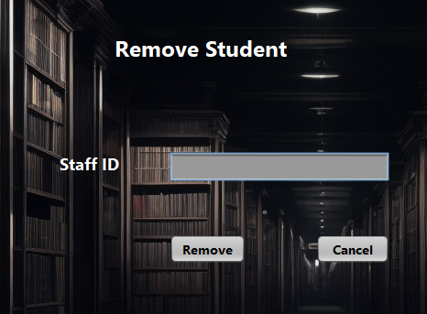
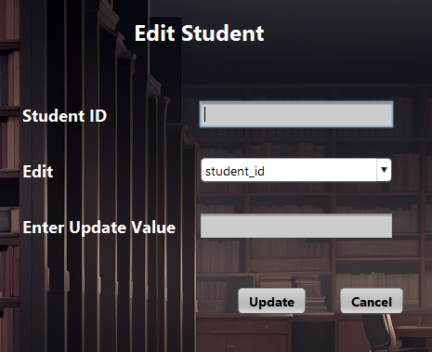
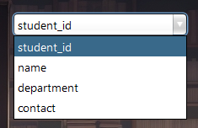


Slide 18
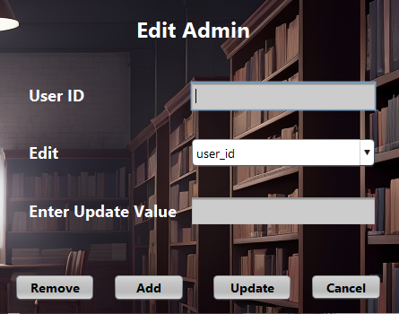
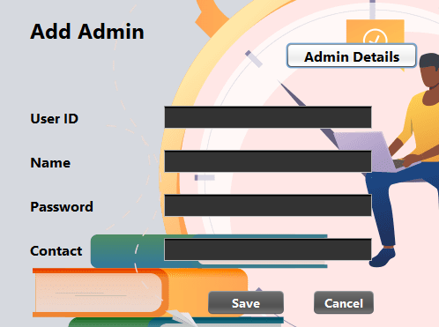
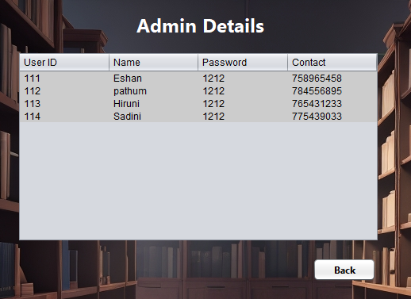
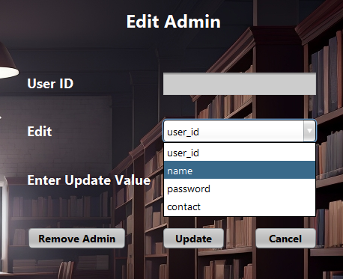

Slide 19
Future Developments
We hope to develop students and staff members can access
We hope to develop this as a web application
Calculate the fine for late return books
Get notification after register new book for student

Slide 20


